Slide 1
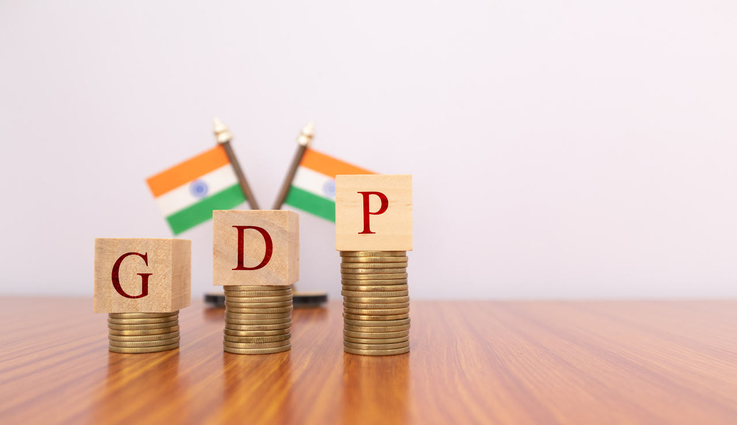
MULTIVARIATE TIME SERIES ANALYSIS OF INDIAN GDP AND IT’S COMPONENTS
PRESENTED BY
AKSHAY DESHMUKH
SRISHTI BATRA
VAISHNAVI INGLE

Slide 2

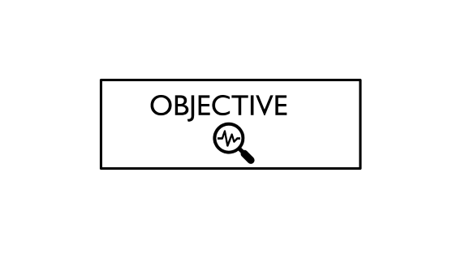
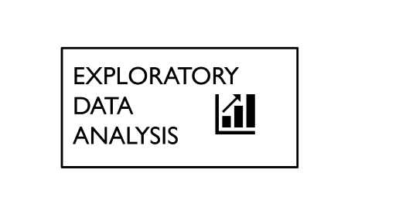
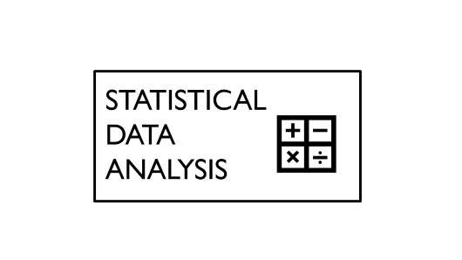


>
>
>
>
>

Slide 3

MOTIVATION AND INTRODUCTION

Slide 4
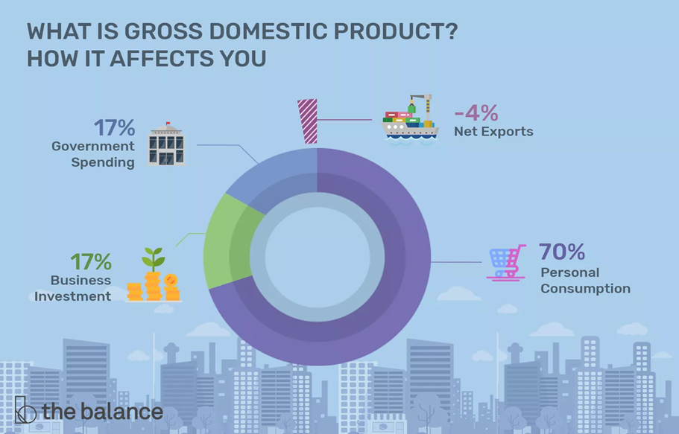
MOTIVATION AND INTRODUCTION
As statistics students and having close relation with economics we’ve always been fond of how
we can study about our country’s economic growth using statistics.
Then, we searched how we can measure the country’s economic growth. The answer is GDP. Economists
consider GDP as an important factor that determines whether an economy is growing or experiencing a recession.
WHAT IS GDP?
GDP is the final value of the goods and services produced within
the geographic boundaries of a country during a specified period
of time, normally a year. GDP growth rate is an important indicator
of the economic performance of a country.
India uses expenditure method to calculate GDP.

Slide 5

OBJECTIVE

Slide 6
OBJECTIVE
To forecast the values of
GDP for upcoming years.
To learn about the practical application of multivariate time series analysis.

Slide 7

DATA SOURCE AND COLLECTION

Slide 8
DATA SOURCE AND COLLECTION
,mm
STATISTICAL TOOLS:-
1.Time Series Analysis
2.Econometrics
We have collected secondary data from the official site of world bank. We got the data of three variables from the year 1960 to 2021. 1.GDP at constant LCU (Dependent Variable) 2.Consumption at constant LCU(Independent variable) 3.Gross Capital formation at constant LCU (Independent variable) (Here LCU means Local Currency Unit) We have dropped the data of the pandemic years to be specific, 2020 and 2021 as it could have given us erroneous results.

Slide 9

EXPLORATORY DATA ANALYSIS

Slide 10
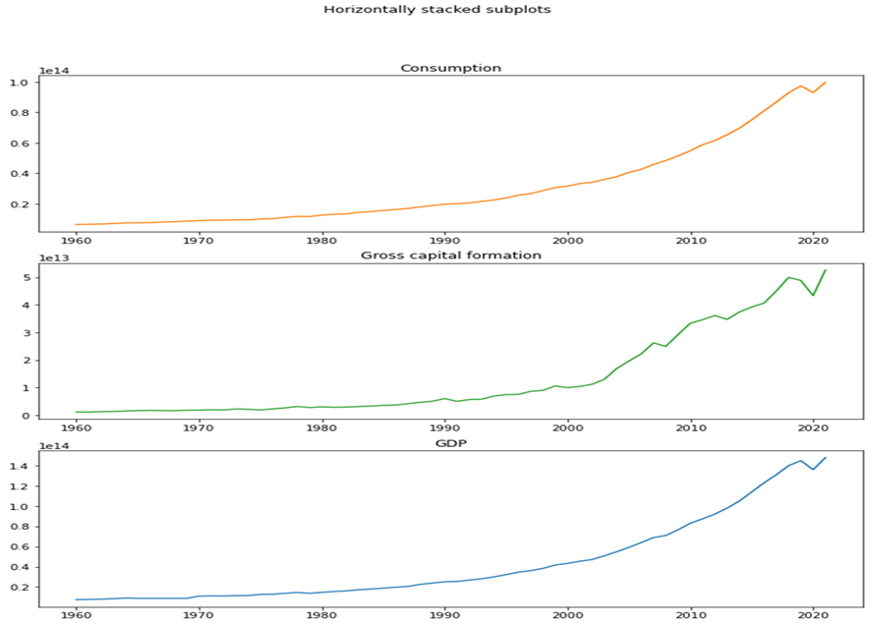
EXPLORATORY DATA ANALYSIS
Plots of Variables

Slide 11
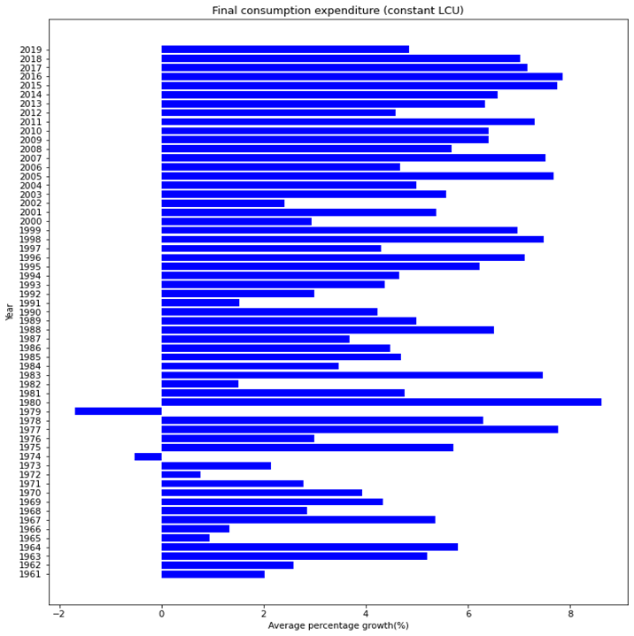
EXPLORATORY DATA ANALYSIS
Final Consumption Expenditure
For the first 30 years, average percentage contribution is around 4 %. the average for the next 30 years is around 6 % which concludes average growth rate for consumption is increased over the years.
We also observe negative growth in consumption in the year 1979-80 because the preceding year under the Janata Party government had led to the strongest recession in the history of modern India.

Slide 12
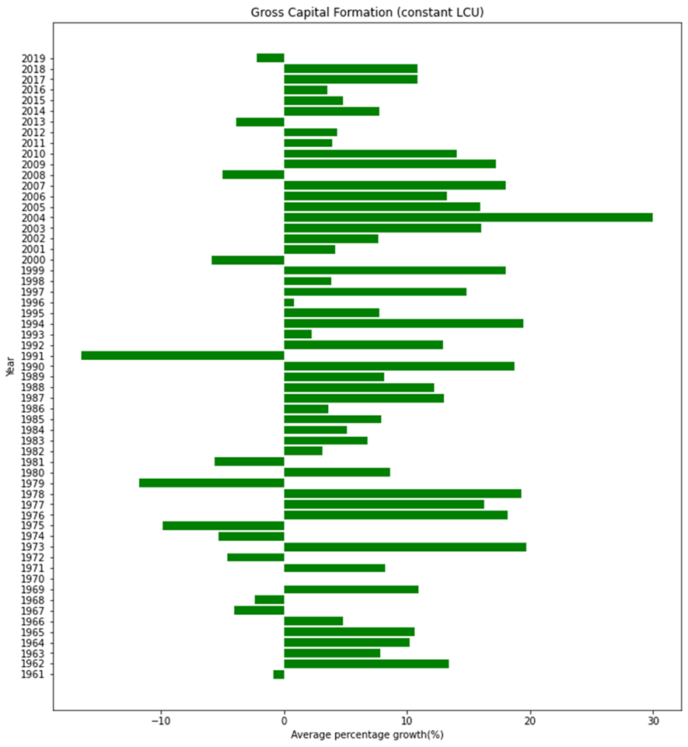
Gross Capital Formation
Here we observe that, there are considerable negative downfalls in the graph but for the first 30 years, average is around 6% and as we go further, the average for next 30 years is around 8 % which concludes average growth rate for Gross capital formation is increased over the years.
We also observe that the maximum negative growth in the gross capital formation is in the year 1991-1992 because of the 1991 Indian economic crisis.

Slide 13
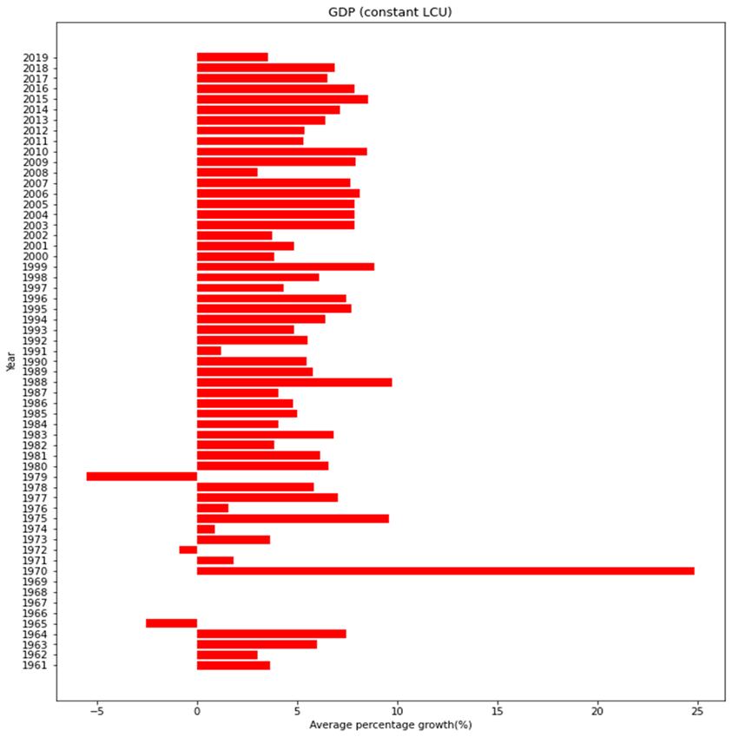
GDP
Here we observe that, there are few negative downfalls and some zero growth rate in the graph, while for the first 30 years, the average is around 4 % but as we go further, the average GDP for the next 30 years is around 6 % which concludes average growth rate for GDP is increased over the years.
We also observe that the highest growth in GDP is seen in the year 1970-1971 because the then prime minister Indira Gandhi announced to the nation that 14 major commercial banks which between them controlled 85 percent of bank deposits in the country, had been nationalized

Slide 14
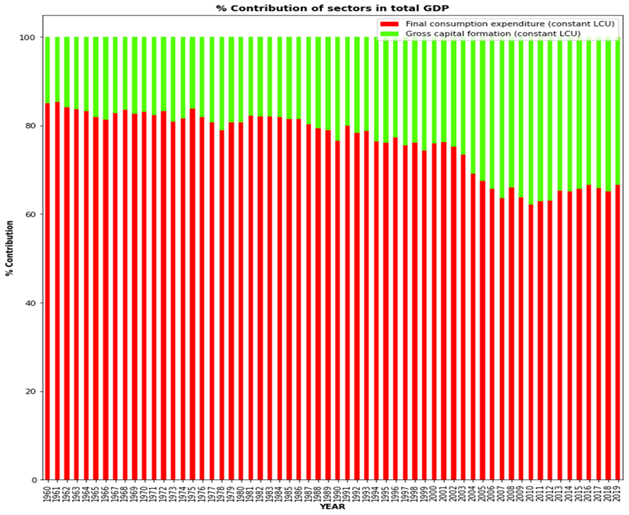
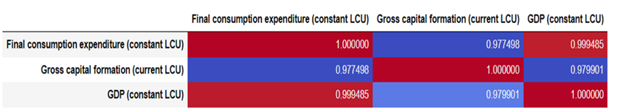
Correlation Analysis
Percentage Contribution (Final Consumption and Gross Capital formation towards GDP)

Slide 15

STATISTICAL
DATA ANALYSIS

Slide 16
STATISTICAL DATA ANALYSIS
All the three Variables were not stationary.
Consumption follows ARIMA(1,2,0).
GCF follows ARIMA(0,2,1).
Univariate time series modelling for independent variables.
Since, all of the variables showed exponential trend we performed log transformation on all of them.
We calculated the order of integration of all the series and found out that all the series are integrated of order I(1).
We performed the Johansen’s test for cointegration and observed that cointegration is present between the series.
Since the order of integration for all the variables is less than 2 which satisfies the assumption for applying the ARDL model, therefore we fitted the model ARDL(10,1) and checked the goodness of fit.
Using the ARDL model, we found the forecasted values for the GDP for the 5 years that is to say, 2020-2024.

Slide 17
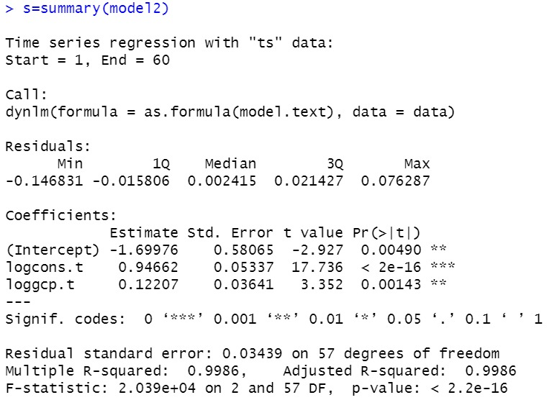
MODEL SUMMARY
R-square=0.9986 .The proportion of the variance for the GDP that is explained by consumption and Gross Capital Formation is 99.86%.

Slide 18
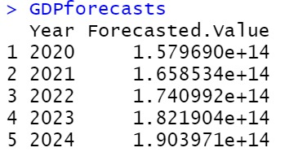
GOODNESS OF FIT
As the errors are small , we conclude that the model is a good fit.
FORECASTS FOR GDP FOR THE YEARS 2020-2024

Slide 19
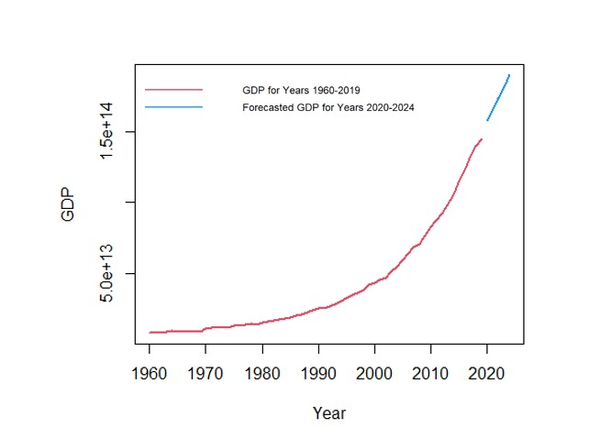
FORECASTS OF GDP

Slide 20

LIMITATIONS

Slide 21
LIMITATIONS
One of the biggest limitations of GDP is that it doesn't count environmental costs. For example, the price of plastic is low because it doesn't include the cost of pollution. GDP doesn't measure how these costs impact the well-being of society. A more accurate measurement of a country's standard of living may include environmental conditions.
Another limitation is that GDP doesn't include unpaid services. It leaves out unpaid child care and volunteer work, for example, despite the significant impact they have on the economy and a country's quality of life.
GDP also does not count the shadow or black economy. It underestimates economic output in countries where many people receive their income from illegal activities.

Slide 22


